Slide 1

WILL IT RAIN TOMORROW?
Predicting Rain Using Machine Learning

Slide 2

PROBLEM STATEMENT
We want to predict: Will it rain tomorrow?
It’s a Yes or No question (called classification).
We’ll use weather data like temperature, humidity, wind, etc.
This can help farmers, travelers, and daily planning.

Slide 3
INTRODUCTION
Weather is important in our lives.
We use machine learning to make smart predictions.
We use past weather data to guess if it will rain next day.

Slide 4
DATASET USED
Source: Australian weather data (from Kaggle)
Has info like:
Temperature
Rainfall
Wind
Humidity
The target column is: "RainTomorrow" – Yes or No
Data has ~145,000 rows

Slide 5


CLEANING THE DATA
Some data was missing – we fixed or removed it
Categorical values (like wind direction) were converted to numbers
Training data (80%)
Test data (20%)

Slide 6
DATA ANALYSIS
We checked how each weather condition affects rain:
More humidity → more chance of rain
Lower pressure → more rain
Less sunshine → more rain

Slide 7
METHODOLOGY - STEP BY STEP
Load dataset using Pandas.
Clean missing values.
Encode categorical data.
Train-test split.
Standardize features.
Train Logistic Regression.
Predict and evaluate model.

Slide 8
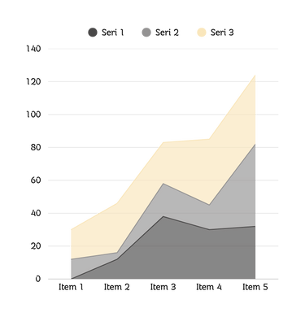
LOGISTIC REGRESSION ALGORITHM
Supervised ML algorithm for binary classification.
Models the probability that RainTomorrow = 1 (Yes).

Slide 9
CONCLUSION
Successfully built a Logistic Regression model to predict rainfall.
Achieved reasonable accuracy and performance using cleaned and preprocessed data.
The model helps in understanding key factors influencing rain.
Logistic Regression is simple yet effective for this classification task.

Slide 10

THANK YOU

